Slide 1
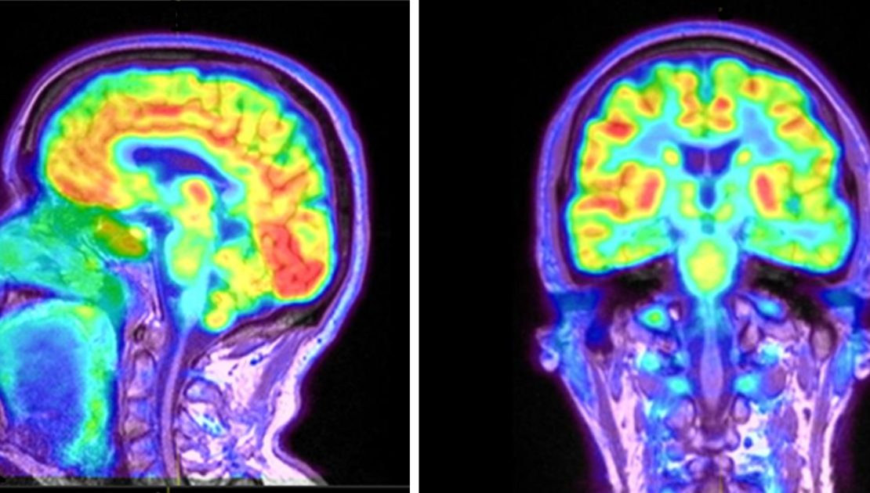
PHYSICS of PET SCAN
Moein Derakhshan
Danial Rahimi

Slide 2
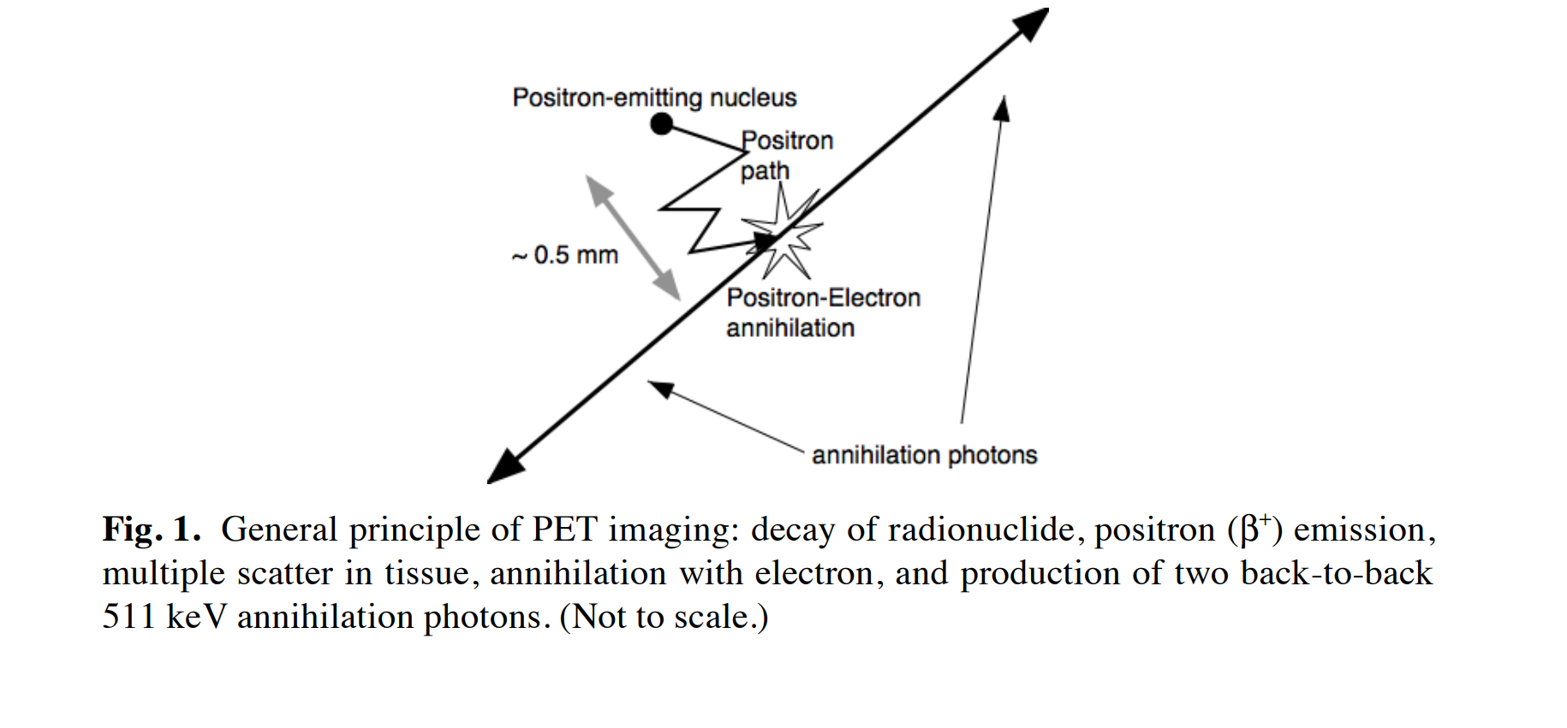
What Makes PET(positron emission tomography) Useful?
PET measures the two annihilation photons that are produced back-to-back after positron emission from a radionuclide tagged tracer molecule, which is chosen to mark a specific function in the body on a biochemistry level. Hence PET provides molecular imaging of biological function instead of anatomy.
The detection of both annihilation photons in coincidence yields increased sensitivity over all other forms of medical imaging
In addition, positron emitting isotopes that are used in medical imaging (C-11, N-13, O-15, F-18, etc.) many of these isotopes can be incorporated into biological substrates (glucose, H2O, NH3, CO2, O2, etc.)

Slide 3
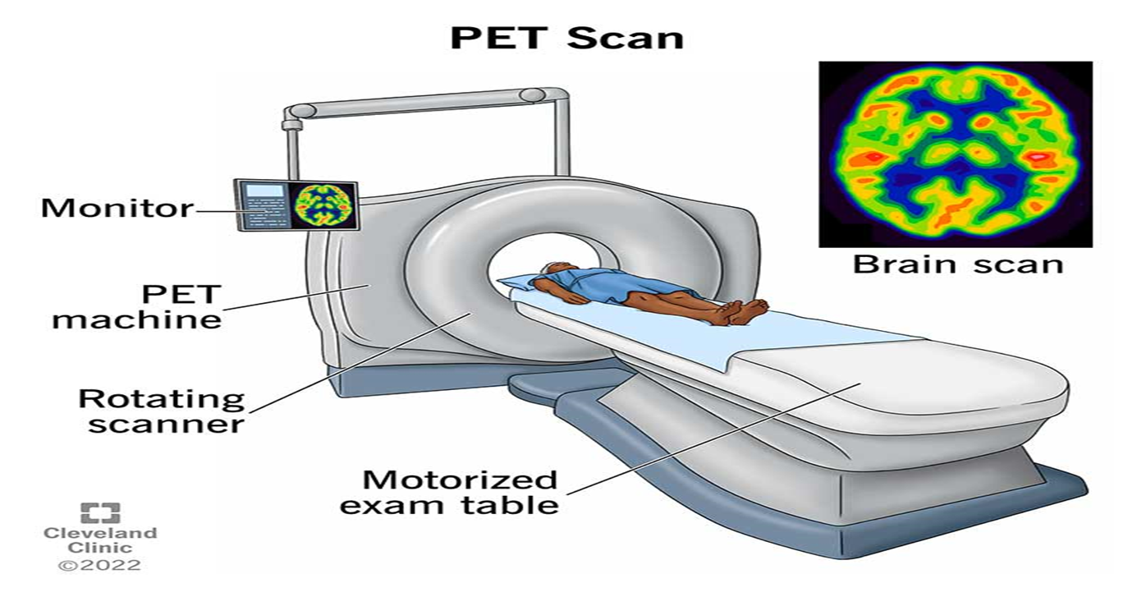
PET imaging with oxygen-15 indirectly measures blood flow to the brain. In this method, increased radioactivity signal indicates increased blood flow which is assumed to correlate with increased brain activity.

Slide 4
CT or PET?
Compared to CT and MR images, PET images appear much blurrier and or noisier, due to the relatively limited number of photons that can be collected during an imaging study. In addition, detector resolution is poorer due to the detector physics. X-ray CT scanners can easily resolve points less than 1 mm in size, while PET scanners cannot reliably resolve point sources smaller than 4-5 mm at best, and closer to 10 mm in practice. However, this does not impair their high sensitivity to focal tracer concentrations or their usefulness in accurate quantitative functional imaging.

Slide 5
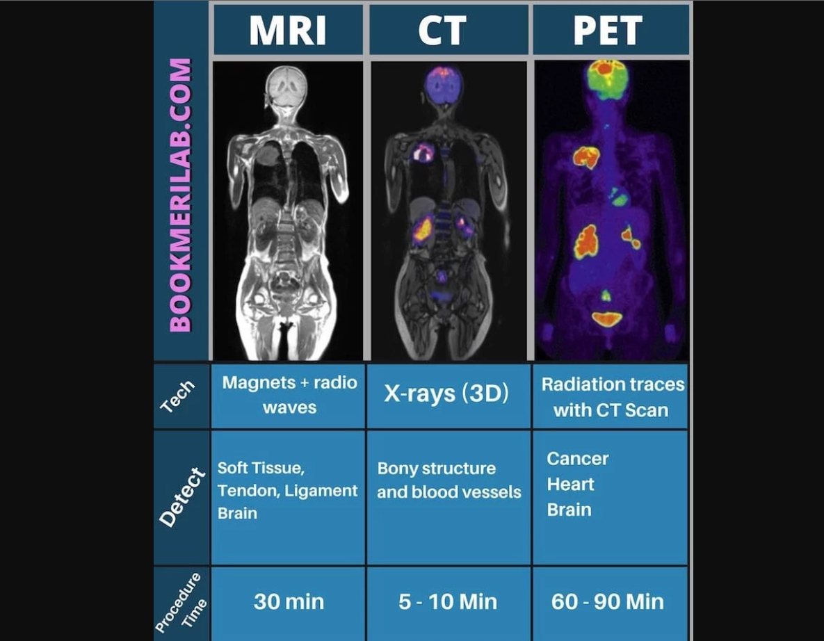

Slide 6
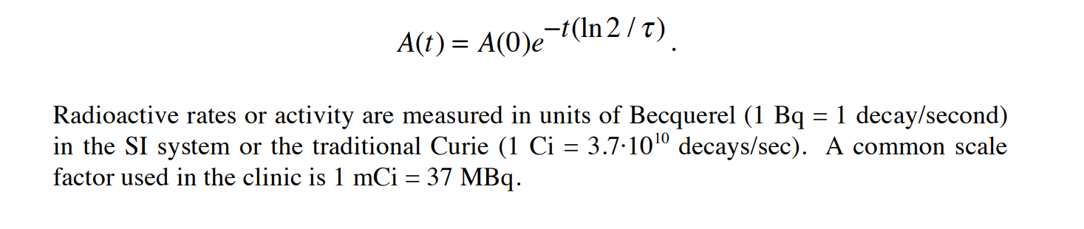
Radioactive Decay
The decay process follows an exponential law. Most common in PET is 18F, which has a half-life of 109 minutes. After some time t, the activity left, A(t), is proportional to the initial number, A(0), and an exponential involving the half-life, τ, of the nuclide:

Slide 7
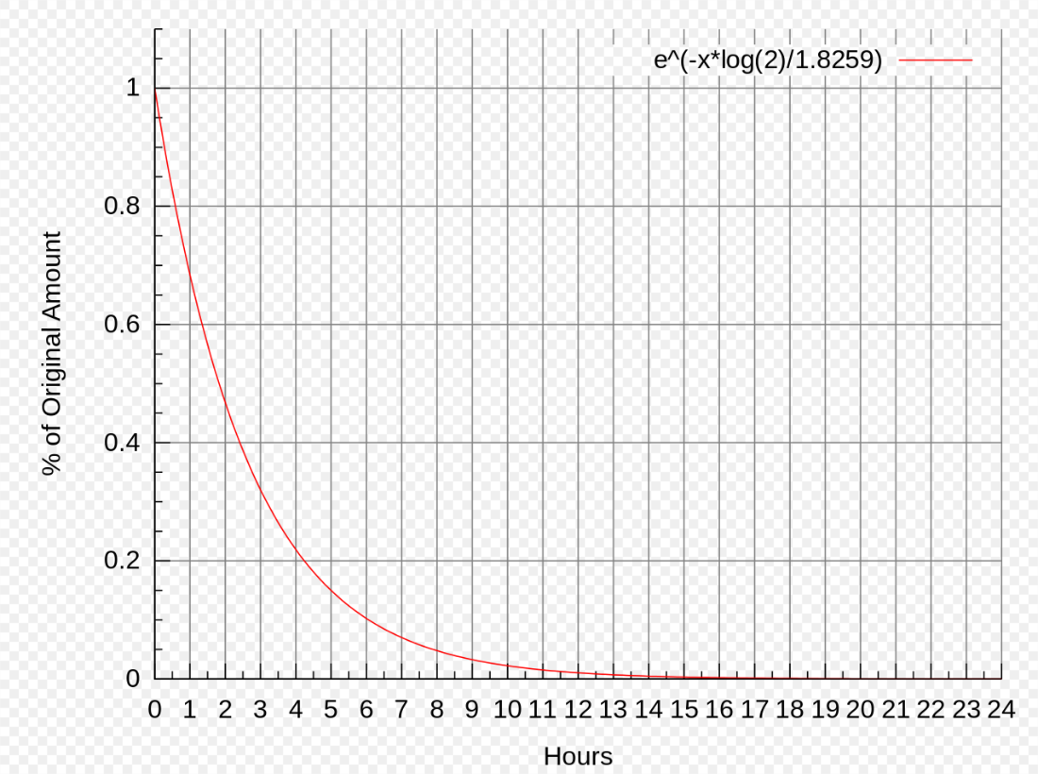

Slide 8
Positron Emission and Annihilation:
In β+ (positron) decay , a nuclide transforms one of its core protons (p) into a neutron (n) and emits a positron (β+ ), essentially a positively charged electron, and a neutrino (ν): p → n + β+ + ν. The average positron range in matter depends on the positron’s energy and material characteristics, such as the density and the atomic number. At the end of its path, the positron, being anti-matter to electrons, will annihilate (recombine) with an atomic electron. In the annihilation, electron and positron convert 3 their mass into energy and produce a pair of 511 keV annihilation photons traveling in opposite directions. The 511 keV photon energy (E) comes from Einstein's famous equation E = mc2 , where m is the mass of the electron or positron and c is the speed of light. This annihilation radiation is what is detected in PET.

Slide 9
Interaction of Photons with Matter:
Compton scatter and other interactions lead to an attenuation of the annihilation photons. The number of photons that are observed in a straight line from where they were produced decreases exponentially with increasing length of the material traversed. The thickness of soft tissue required to reduce the intensity of a beam by one half is approximately 7 cm, as opposed to 3-4 cm for x-rays. This after ~14 cm of soft tissue the 511 keV annihilation photon flux would be reduced to ¼ of its original intensity, and through the abdomen the photon flux can be reduced to 1/50 of its original intensity. Thus attenuation is often the dominant factor in PET image quality, especially for thicker patients

Slide 10
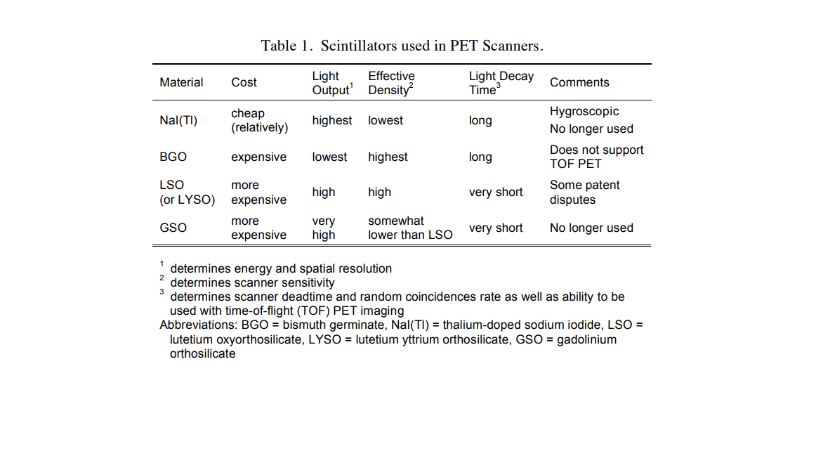
Data Acquisition:
In most PET scanners today, scintillation detectors are used as detection elements. They couple inorganic scintillation crystals that emit visible or near ultraviolet light after interaction with an incident high-energy (511 keV) photon, to photo detectors that detect and measure the scintillation photons.
In scintillation crystals, the incident annihilation photon (nominally 511,000 eV energy) interacts and creates tens of thousands visible wavelength photons (about 1 eV energy each) in a very short flash or 'scintillation'. The number of scintillation photons produced in the crystal is proportional to the energy deposited by the annihilation photon

Slide 11
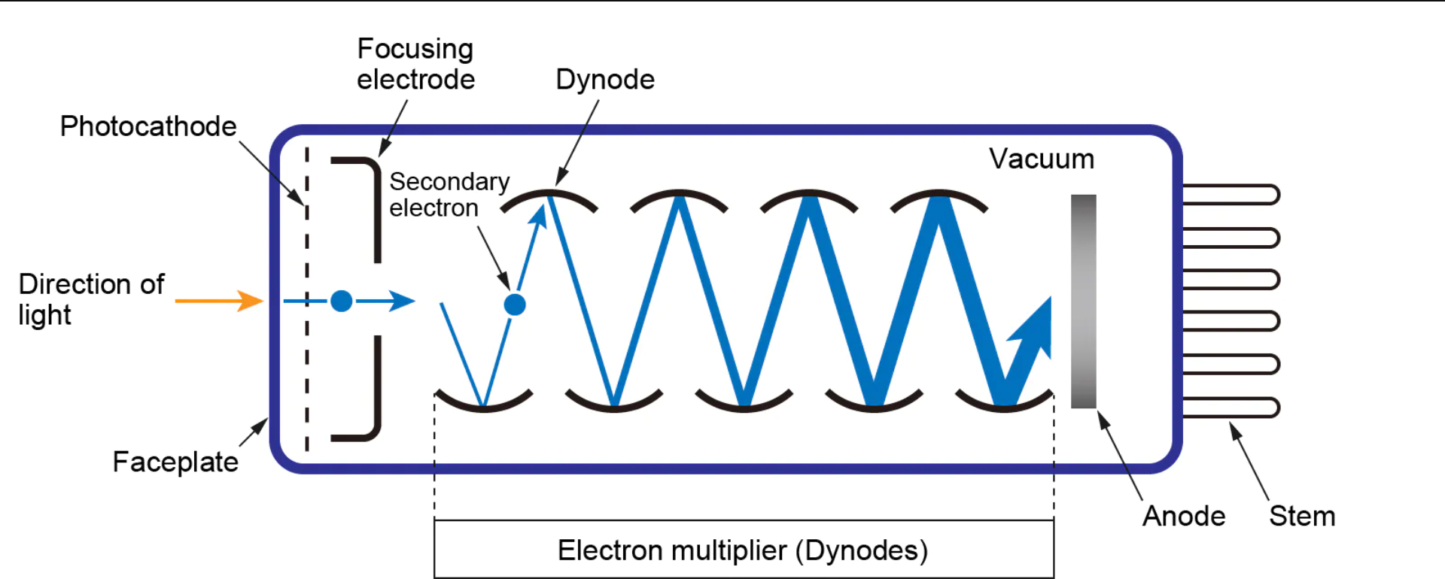
The most commonly used photo detectors for PET are photo-multiplier tubes (PMTs). PMTs are vacuum tubes with a photo cathode where incoming light photons produce electrons that are accelerated and amplified. The resulting electrical current is proportional to the number of initial scintillation photons and therefore to the energy deposited in the scintillation crystal by the PET photon

Slide 12
Data Correction
The PET data acquisition process is not a perfect one.
Attenuation of the emitted photons due to interactions in patient’s body
detector elements vary in their detection efficiency
random and scattered coincidences
These effects need to be corrected.

Slide 13
Attenuation Correction (AC)
Photons that encounter more or denser material on their path from the annihilation site to the detectors are more likely to be absorbed or scattered than photons that travel through sparser parts of the body. If images are reconstructed from sinograms without AC, this can lead to less dense areas, like the lungs, appearing darker (emitting more photons) than surrounding denser tissue.
It not only impairs the visual appearance of the image, but also leads to wildly inaccurate quantitation of tracer uptake.

Slide 14
So we need to determine the attenuation through the patient for all LORs.
On stand-alone PET scanners, this is done with a transmission scan where an external positron source is rotated around the patient and the attenuation of the transmitted photons is determined.
In PET/CT scanners, the acquired CT image is used for PET attenuation correction.

Slide 15
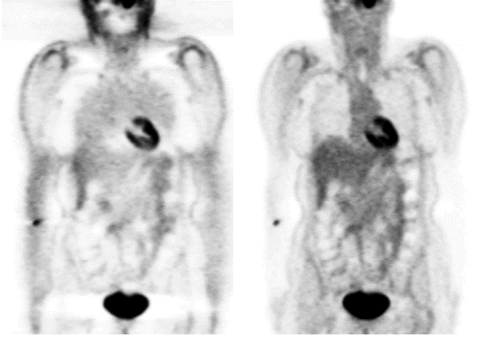
Whole-body PET image without (left) and with (right) attenuation correction. Artifacts from not performing attenuation correction include the lungs and skin showing higher tracer uptake than muscle.

Slide 16
2D versus 3D acquisitions
PET scanners consist of several rings of detector elements that may or may not be separated by thin annular rings or septa of photon-absorptive material, typically tungsten.
What do we mean by 2D and 3D?

Slide 17
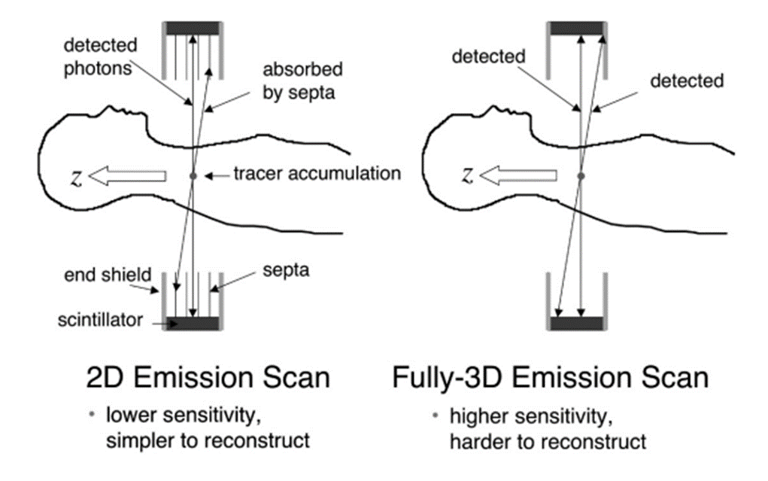

Slide 18
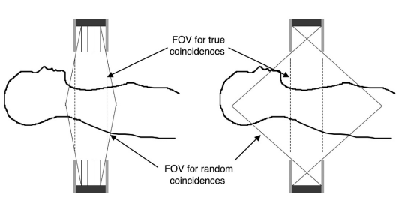

Slide 19
2D or 3D? That’s the question
The decision on whether to use 2D or fully 3D acquisitions is still under debate, weighing the reduction of background counts against the loss of sensitivity.
Brain imaging – typically with small activity concentrations outside the true FOV – is a clear indication for 3D imaging with increased sensitivity, while whole-body imaging – with usually much more activity directly surrounding the true FOV – does not show a clear preference and is usually done in 2D mode on scanners with 2D/3D capabilities.

Slide 20
Image Reconstruction
PET processing chain
the acquisition of PET data in sinograms
corrections for attenuation and other effects
image
reconstruction

Slide 21
Image Reconstruction
The most mathematically complex step
Two methods:
Filtered-backprojection (FBP) : is well-understood and robust (it is also used in CT), but it does not account for noise.
ordered-subsets expectation maximization (OSEM), which is a more recent iterative approach that allows for a more accurate model of the PET acquisition process
Noise/Resolution Tradeoffs and Image Quality

Slide 22
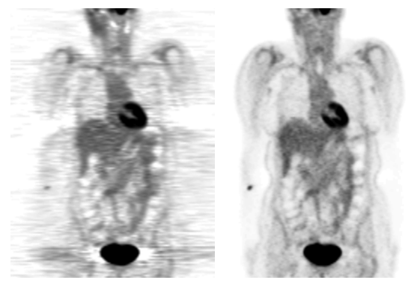
Comparison of coronal sections of PET images reconstructed with FBP (left) and OSEM (right)

Slide 23
Image Reconstruction
Modeling the noise in the data sets generates much more complicated sets of equations that can only be solved iteratively, such as with the expectation maximization (EM) algorithm. This process is too slow for clinical needs, but with the advent of the ordered-subsets acceleration of the EM algorithm (OSEM) and faster processors, iterative methods are becoming more common. In many PET centers OSEM is now the reconstruction method of choice.

Slide 24
Smoothing process
If images appear very noisy after reconstruction, they may be smoothed in a further step to give the eye an easier task, especially for localizing disease.
However, since smoothing averages together neighboring image pixels, it is connected to a loss of resolution, so small structures may not be distinguishable anymore.

Slide 25
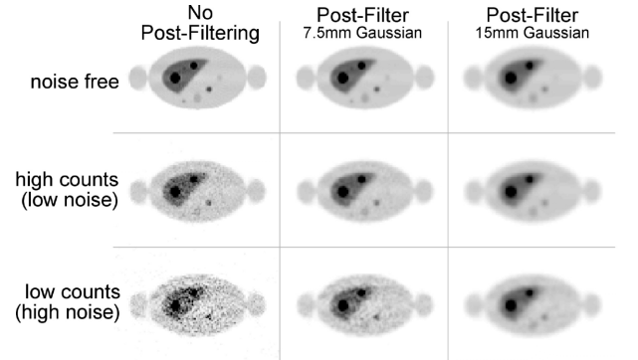
OSEM images showing the tradeoffs between noise and smoothing

Slide 26
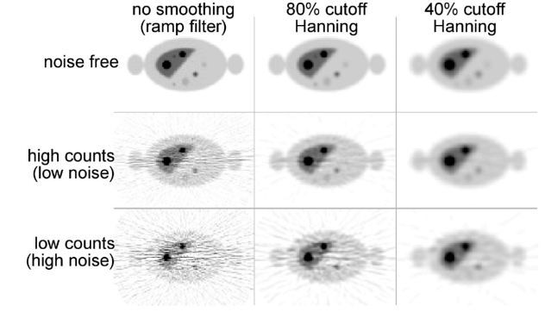
FBP images showing the tradeoffs between noise and smoothing

Slide 27
Comparison with other scans/tests
PET scans show metabolic changes occurring at the cellular level in an organ or tissue. This is important because diseases often begin at the cellular level. CT scans and MRIs cannot reveal problems at the cellular level.
PET scans can detect very early changes in your cells. CT scans and MRIs can only detect changes later, as a disease alters the structure of your organs or tissues.

Slide 28
Sometimes these tests are used along with PET scans to give doctors a clearer picture of the inside of your body. This is often called PET/CT or a PET/MRI scan. In this case, the tests are performed at the same time.
On its own, a CT scan uses special X-ray equipment to produce pictures of the inside of the body.
MRI scans use magnetic fields and radio frequency pulses to create images of internal structures such as organs, soft tissues, and bone.
When either of these scans is performed in conjunction with a PET scan, they result in what’s called image fusion. A computer combines the images from the two scans to create a three-dimensional image, which provides more information and allows for a more precise diagnosis.

Slide 29
PET/CT Scanner Design
Main purpose of this combination is the precise anatomical localization of regions identified on the PET tracer uptake images.
In recent years, the advent of combined PET/CT systems has pushed dedicated pure PET scanners almost completely off the market due to the convenience and ease of creating co-registered PET and CT images for oncology, radiation oncology, and cardiology applications.
PET/CT systems are combinations of stand-alone CT and PET scanners in one gantry with a shared patient bed. They must be able to be very accurately aligned. The patient bed is an important and non-trivial component, because there should be no differential bending in the bed between the PET and CT scans

Slide 30
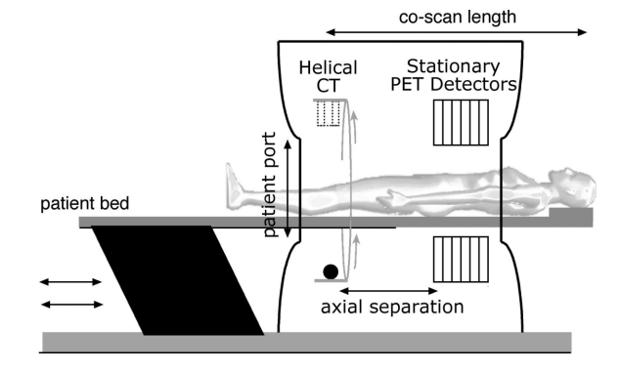
The typical PET/CT protocol begins with a CT scout scan to define the scan area, followed by a helical CT scan, and finally the PET scan.
Each sub-system has its separate acquisition system with 3 or more databases overall (CT, PET, and PET/CT display).

Slide 31
overlaid images of a whole-body scan
anatomical CT image
functional PET

Slide 32
CT-based Attenuation Correction (CTAC)
An important synergy of PET/CT scanners is the use of the CT images for attenuation correction of the PET emission data.
Advantages:
CT data has much lower statistical noise and can be acquired in a shorter time than a standard PET transmission scan.
CT transmission scans can also be acquired after the PET tracer is injected, giving the ability to collect unbiased post-injection transmission scans

Slide 33
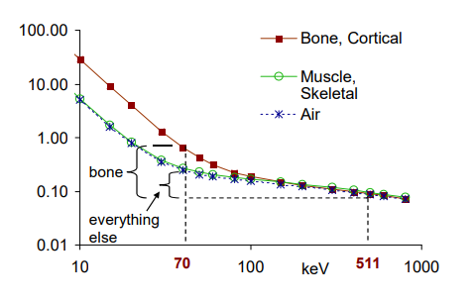
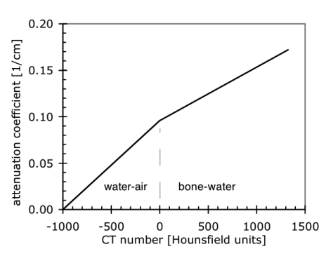
To be used for attenuation correction, the CT data must be transformed to an estimate of the attenuation coefficients at 511 keV. In the bilinear scaling method, the attenuation map at 511 keV is estimated by using separate scaling factors for bone and non-bone components based on the CT image values

Slide 34
There is no unique transformation from CT energies (~30 to 140 keV) to 511 keV due to the possibility of independent variations in density and atomic number Z, which can allow two materials with different atomic numbers to have similar CT values and different attenuation coefficients at 511 keV. Conversely, it is possible for two distinct materials with the same value of attenuation coefficient at 511 keV to yield different CT numbers. This case arises if contrast agent or metallic or high-density implants are present in the CT image.
if there are positional mismatches between the PET and CT images due to, for example, respiratory motion, there will also be errors introduced into the PET image.

Slide 35
As conclusion, while CT-based attenuation correction can lead to significant improvements in PET image quality, artifacts can arise from the presence of contrast agent, metallic or high-density implants, and respiratory motion.
Thanks for your attention ☺ ☺

